Slide 1

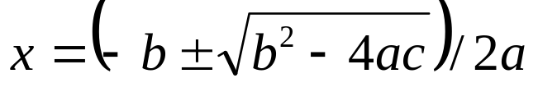
Introduction to Numerical Methods
Second-order polynomial equation:
analytical solution (closed-form solution):
For many types of problems, such as a 5th-order polynomial, a closed-form or analytical solution does not exist. Then the iterative, or numerical, approach must be used.
MAT2001

Slide 2
Characteristics of Numerical Methods
The solution procedure is iterative, with the accuracy of the solution improving with each iteration.
The solution procedure provides only an approximation to the true, but unknown, solution.
An initial estimate of the solution may be required.
The algorithm is simple and can be easily programmed.
The solution procedure may occasionally diverge from rather than converge to the true solution.
MAT2001

Slide 3

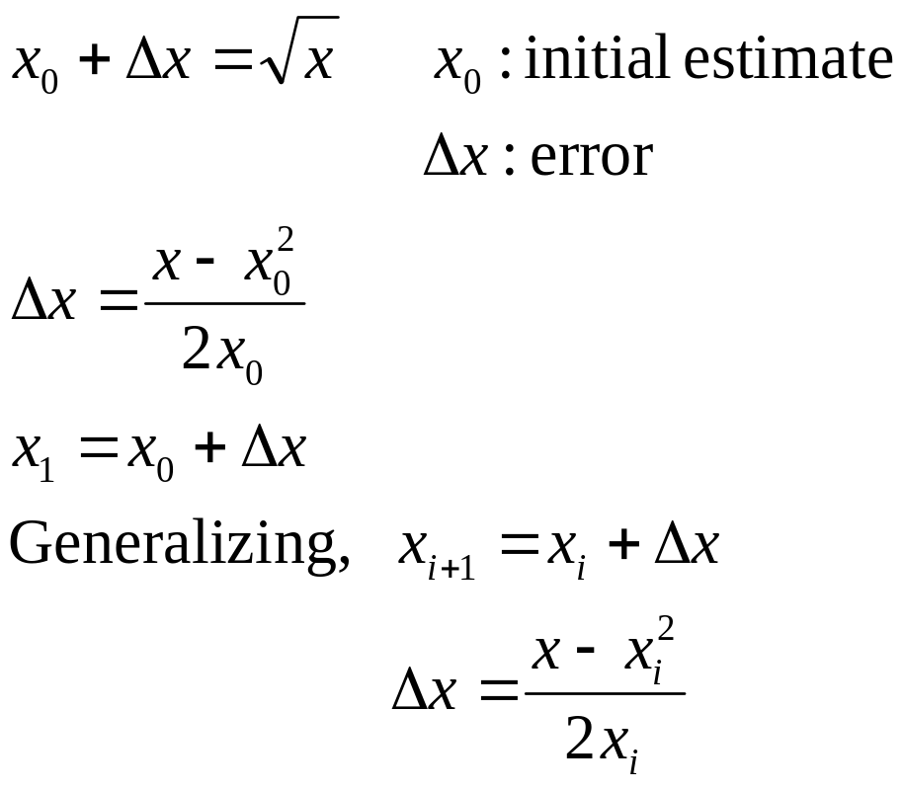
Example: Square Root
To find the value of
MAT2001

Slide 4
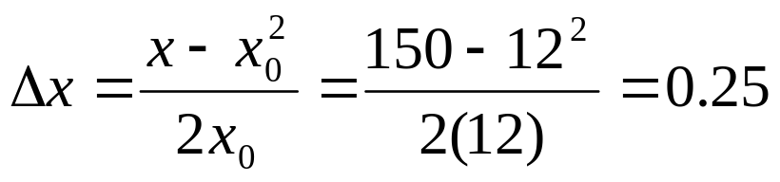
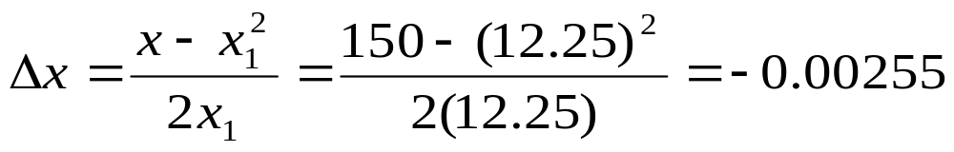
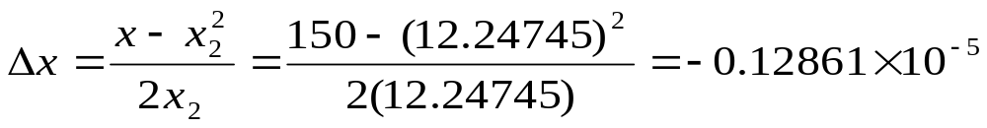

Assume x=150. Because 12²=144, let x₀=12.
MAT2001

Slide 5
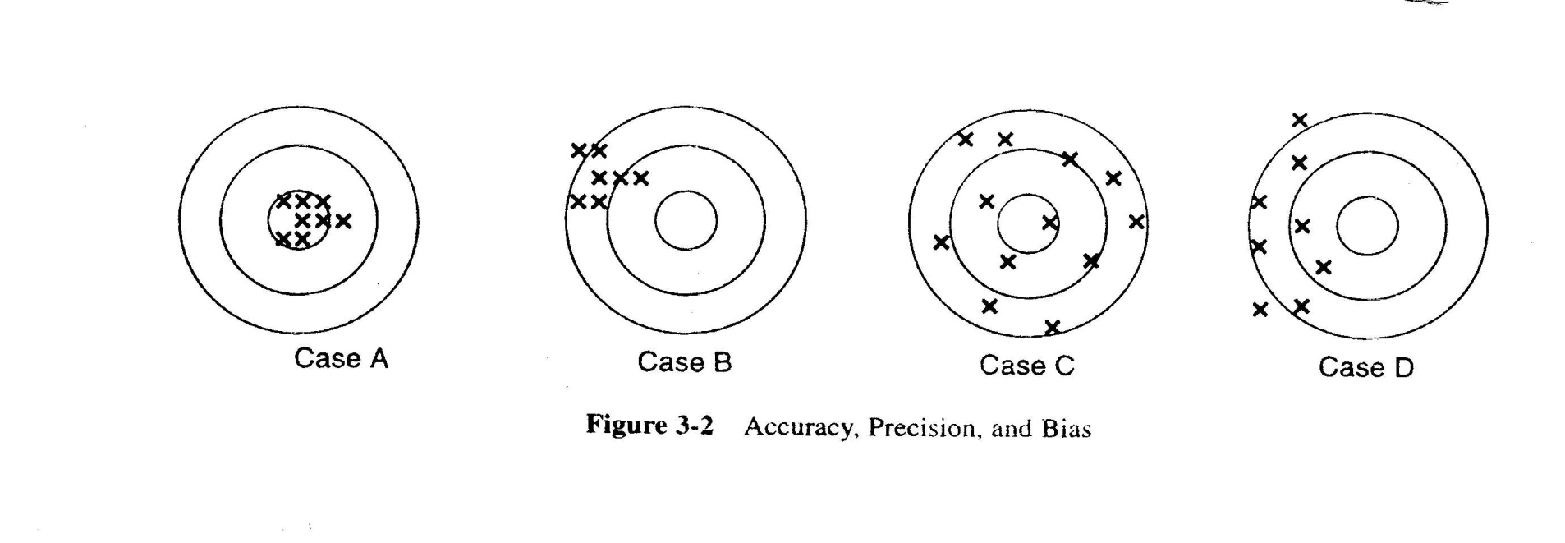
Accuracy, Precision and Bias
Four shooting results:
A is successful.
B : holes agree with each other (consistency or precision), but they deviate considerably from where the shooter was aiming (no correctness)
MAT2001

Slide 6
B lacks correctness (exactness).
C lacks both correctness and consistency.
D lacks consistency (precision).
The shooters of targets C and D were imprecise.
Precision: The ability to give multiple estimates that are near to each other (a measure of random deviations).
Bias: The difference between the center of the holes and the center of the target (a systematic deviation of values from the true value).
Accuracy: The degree to which the measurements deviate from the true value.
MAT2001

Slide 7
Summary of Bias, Precision and Accuracy
Target | Bias | Precision | Accuracy
A | None (unbiased) | High | High
B | High | High | Low
C | None (unbiased) | Low | Low
D | Moderate | Low | Low
MAT2001

Slide 8
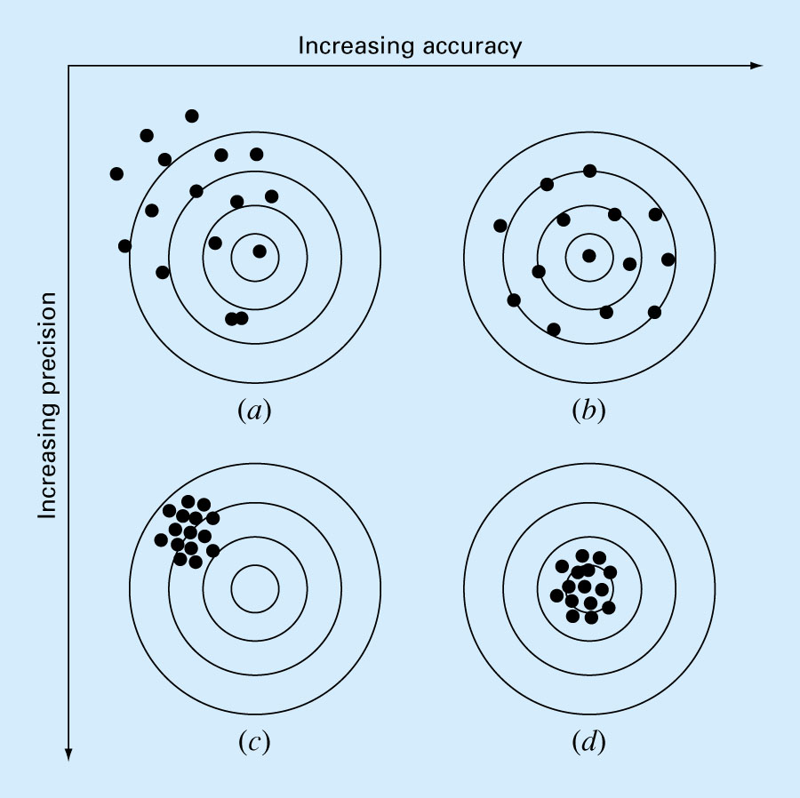
MAT2001

Slide 9
Significant Figures
If 46.23 is exact to the four digits shown, it has four significant digits (The last digit is imprecise). The error is no more than 0.005.
The digits from 1 to 9 are always significant, with zero being significant where it is not being used to set the position of the decimal point.
2410, 2.41, 0.00241: three significant digits
(0 in 2410 is only used to set the decimal place.)
Scientific notation can be used to avoid confusion:
2.41×10³: three significant digits
2.410×10³: four significant digits
MAT2001

Slide 10
Number of significant figures indicates precision. Significant digits of a number are those that can be used with confidence, e.g., the number of certain digits plus one estimated digit.
53,800 How many significant figures?
5.38 x 10⁴ 3
5.380 x 10⁴ 4
5.3800 x 10⁴ 5
Zeros are sometimes used to locate the decimal point not significant figures.
0.00001753 4
0.0001753 4
0.001753 4
MAT2001

Slide 11
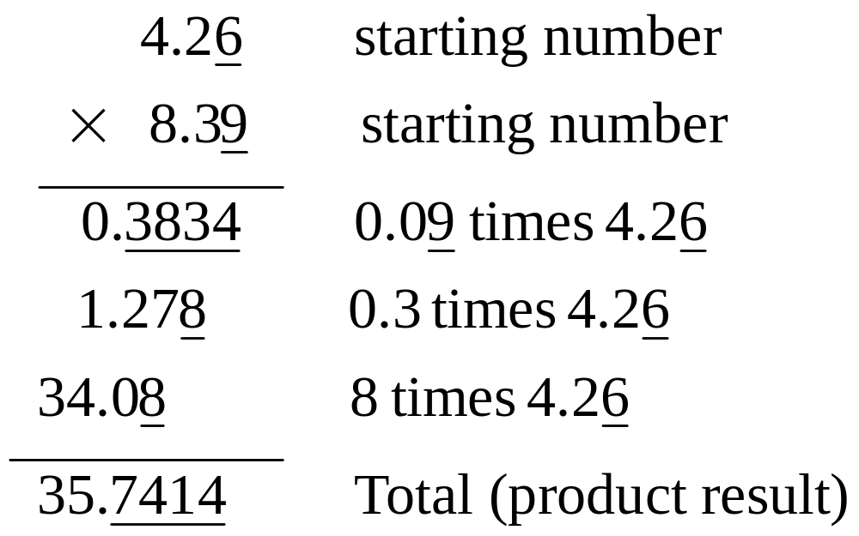
Computation : Any mathematical operation using an imprecise digit is imprecise.
Example: 3 significant digits (underline indicates an imprecise digit.)
MAT2001

Slide 12





Example: Compute
Rounding should be made at the end of computation, not at intermediate calculation
Table: Rounding Numerical Calculations
1 | 13.59 | 13.576 | 13.573
20 | 51.40 | 51.310 | 51.307
40 | 91.20 | 91.030 | 91.027
100 | 210.60 | 210.19 | 210.187
MAT2001

Slide 13
Example: Arithmetic Operations and Significant Digits. To compute the area of a triangle:
base=12.3 3 significant digits
height=17.2 3 significant digits
area A=0.5bh=0.5(12.3)(17.2)=106
(If we ignore the concept of significant digits,
A=105.78)
The true value is expected to lie between
0.5(12.25)(17.15)=105.04375
and 0.5(12.35)(17.25)=106.51875
Note that 0.5 is an exact value, though it has only one significant digit.
MAT2001

Slide 14
Error Types
In general, errors can be classified based on their sources as non-numerical and numerical errors.
Non-numerical errors:
(1) modeling errors: generated by assumptions and
limitations.
(2) blunders and mistakes: human errors
(3) uncertainty in information and data
MAT2001

Slide 15
Numerical errors:
(1) round-off errors: due to a limited number of
significant digits
(2) truncation errors: due to the truncated terms
e.g. infinite Taylor series
(3) propagation errors: due to a sequence of
operations. It can be reduced with a good
computational order. e.g.
In summing several values, we can rank the
values in ascending order before performing
the summation.
(4) mathematical-approximation errors:
e.g. To use a linear model for representing a
nonlinear expression.
MAT2001

Slide 16

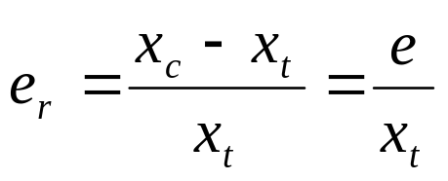
Measurement and Truncation Errors
error(e): the difference between the computed (x_{c}) and true (x_{t}) values of a number x
The relative true error (e_{r}) :
MAT2001

Slide 17
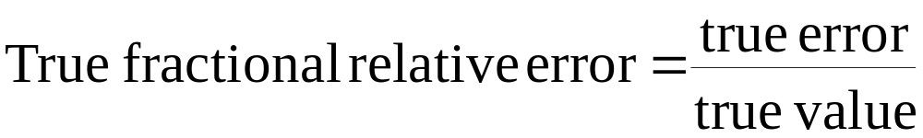
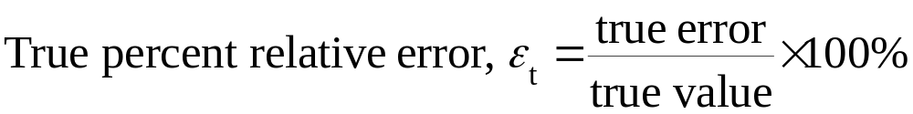
True Value = Approximation + Error
E_{t} = True value – Approximation (+/-)
True error
MAT2001

Slide 18
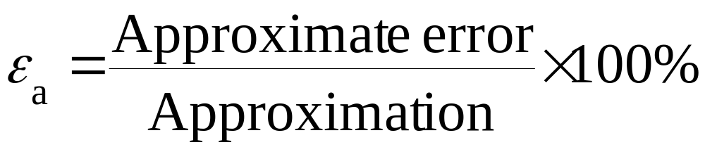
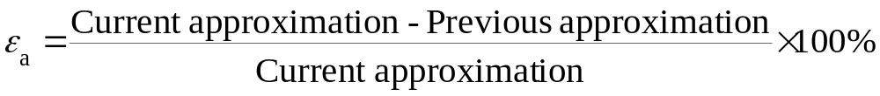
For numerical methods, the true value will be known only when we deal with functions that can be solved analytically (simple systems). In real world applications, we usually not know the answer a priori. Then
Iterative approach, example Newton’s method
(+ / -)
MAT2001

Slide 19
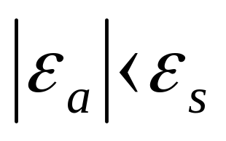
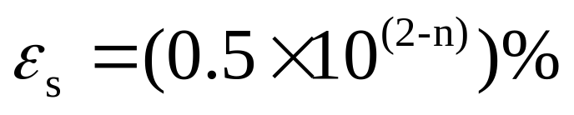
Use absolute value.
Computations are repeated until stopping criterion is satisfied.
If the following criterion is met
you can be sure that the result is correct to at least n significant figures.
Pre-specified % tolerance based on the knowledge of your solution
MAT2001

Slide 20
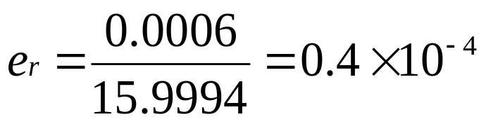
Example: Truncation Error in Atomic Weight
The weight of oxygen is 15.9994. If we round the atomic weight of oxygen to 16, the error is
e = 16 - 15.9994 - 0.0006
The relative true error:
MAT2001

Slide 21

Error Analysis in Numerical Solutions
In practice, the true value is not known, so we cannot get the relative true error.
e_{i} = x_{i} – x_{t}
where e_{i} is the error in x at iteration i, and x_{i} is the computed value of x.
e_{i+1} = x_{i+1} – x_{t}
Relative error:
is used to measure the error.
MAT2001

Slide 22

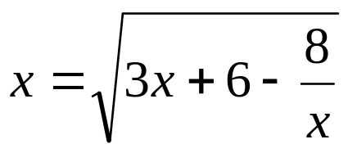
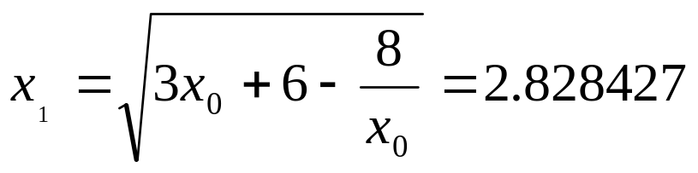
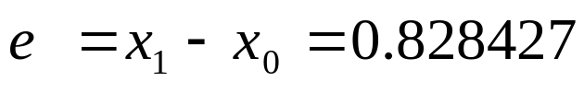
Example: Numerical Errors Analysis
The initial estimate x₀ = 2
error:
See the table on the next page.
MAT2001

Slide 23




Table: Error Analysis with x_{t} =4
Trail
0 | 2.000000 | - | 2.000000
1 | 2.828427 | 0.828427 | 1.171573
2 | 3.414214 | 0.582786 | 0.585786
3 | 3.728203 | 0.313989 | 0.271797
4 | 3.877989 | 0.149787 | 0.122011
5 | 3.946016 | 0.068027 | 0.053984
6 | 3.976265 | 0.030249 | 0.023735
7 | 3.989594 | 0.013328 | 0.010406
8 | 3.995443 | 0.005849 | 0.004557
9 | 3.998005 | 00002563 | 0.001995
10 | 3.999127 | 0.001122 | 0.000873
MAT2001

